Slide 1
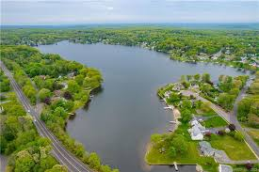
Safeguarding Cedar Lake: Awareness and Action Against Invasive Weeds- Emphasis on Hydrilla and Milfoil
Presented to the Cedar Lake Association by Celina Bunn, environmental committee Date: June 2026

Slide 2
Why This Presentation Matters
Many lakes in Connecticut are now dealing with serious invasive aquatic weed infestations.
Once these plants enter a lake:
. They spread rapidly
. They are extremely expensive to control
. Eradication is rarely possible
Goal of tonight’s presentation:
Protect our lake before it becomes a problem serious enough to threaten the
Very existence of Cedar Lake as a boating and swimming resource!

Slide 3
What Are Invasive Aquatic Species
. Non-Native plants and animals that spread aggressively and
outcompete local varieties, disrupting ecosystems
. Our Focus: Hydrilla and Eurasian Watermilfoil
. Introduced via aquarium trade, Boats or waterfowl
. Why Cedar Lake? Proximity to affected CT waterways increases
risk

Slide 4
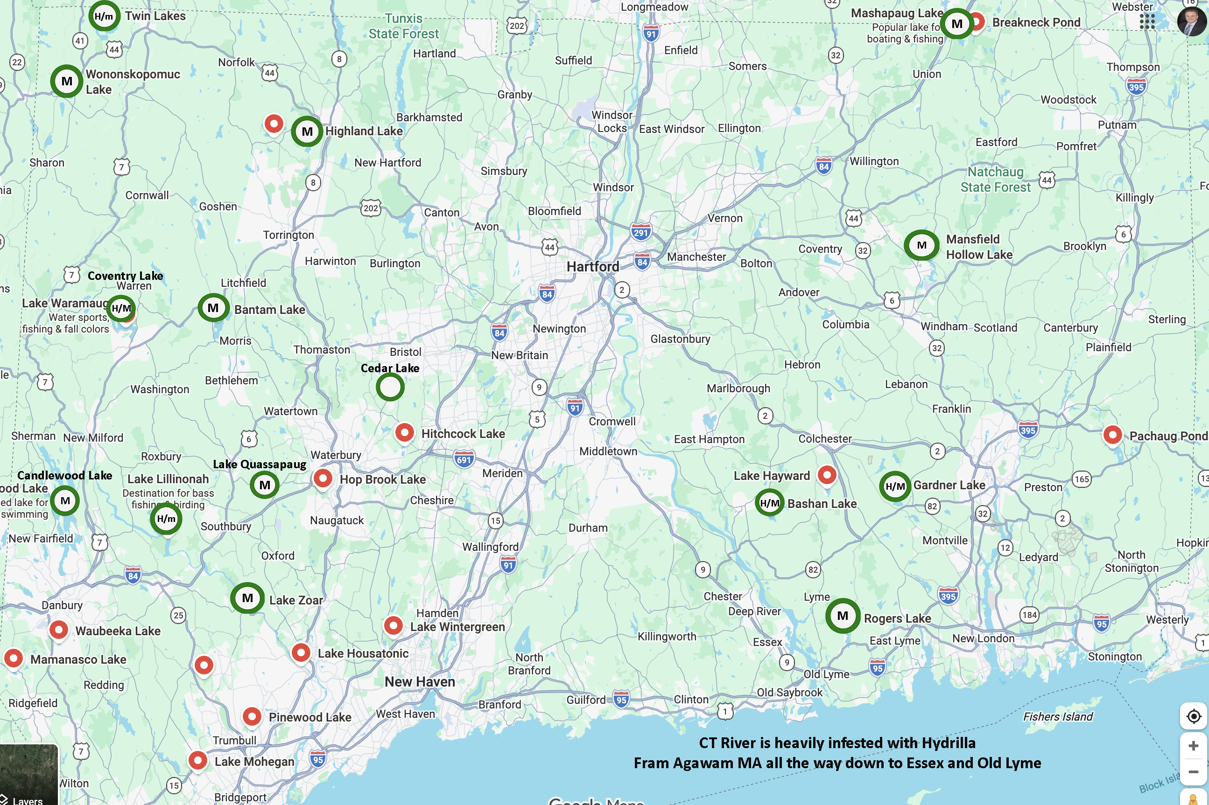
Affected Waterways: H (Hydrilla M (Milfoil)

Slide 5
Why our Waterways are Vulnerable
Invasive Aquatic plants reproduce extremely easily.
They spread through:
. Seeds
. Stem Fragments
. Root fragments
. Underground tubers ( Potato like bulbs on the roots)
Important fact:
A fragment only a few inches long can start a new infestation

Slide 6
Hydrilla and Milfoil aren’t Just a Nuisance-They’re entire Ecosystem Disruptors!
Lets Take A Closer Look

Slide 7
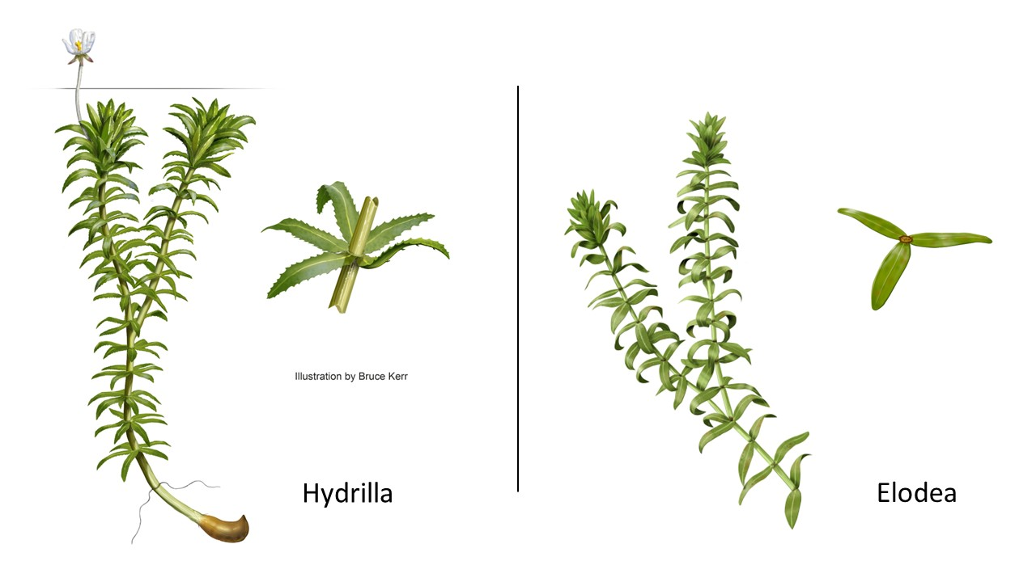
The Most Concerning Plant: Hydrilla
. Submerged perennial plant with long, branching stems (up to 30 ft)
. Leaves: Whorled in groups of 4-8, pointed with serrated edges
. Flowers: Tiny, white, floating (rarely seen)
. Key Trait: Forms tubers (reproductive
structures on the roots) and turions-
winter buds capable of growing into a plant.

Slide 8
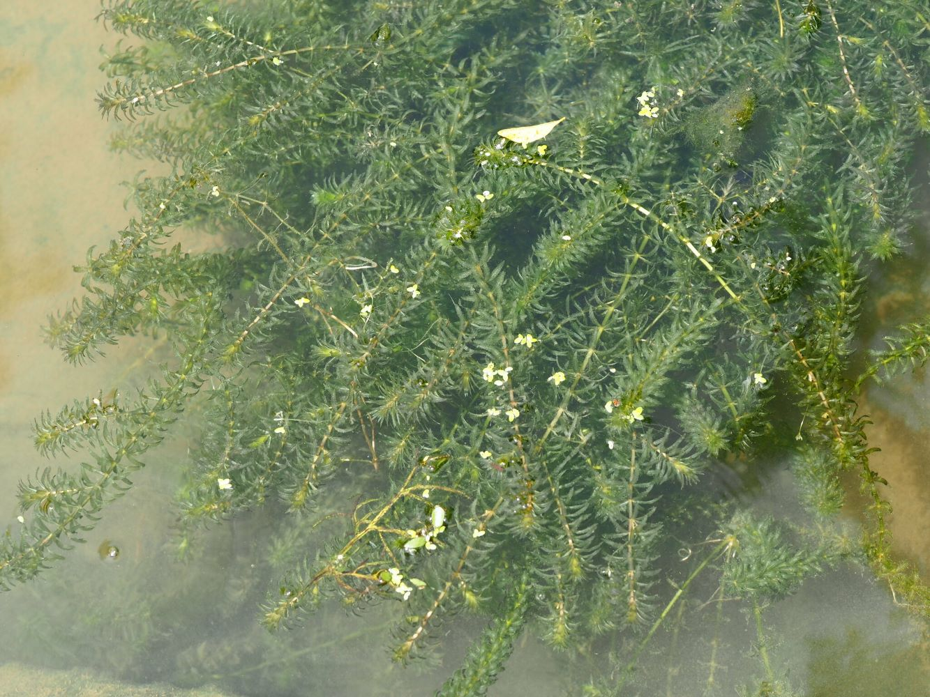

Slide 9
Growing Characteristics of Hydrilla
Rapid Growth & Spread: Stems can grow 20-30 feet long, with 50-80% of biomass concentrated in the top 2 feet of the water column, forming thick, shading mats. Grows at a rate of 1 inch per day.
Reproduction Mechanisms: It spreads efficiently through stem fragments, buds (turions) that break off, and tubers that grow in the sediment. These tubers can remain viable for up to seven years in the soil. A single sprouting tuber can lead to a heavily branched, dense mat of vegetation.
Environmental Adaptability: Thrives in low light (1% of full sunlight) and can grow in various depths, from shallow water to 30 feet.
Seasonal Behavior: Early in the season, it grows along the bottom; as temperatures rise, it extends toward the surface, with intense branching.
Impact: Creates dense surface mats that block sunlight, reduce oxygen levels, impede water flow, displace native aquatic vegetation and lead to fish kills.

Slide 10
Eurasian Water Milfoil
. Submerged plant with feather-like leaves in whorls of 3-4 around
the stem.
. Leaves: 12-20+ leaflets per leaf, finely divided, 1-2 inches long.
. Stems: Reddish-brown, branching near the surface.
. Flowers: Small spikes above water (pink/red)

Slide 11
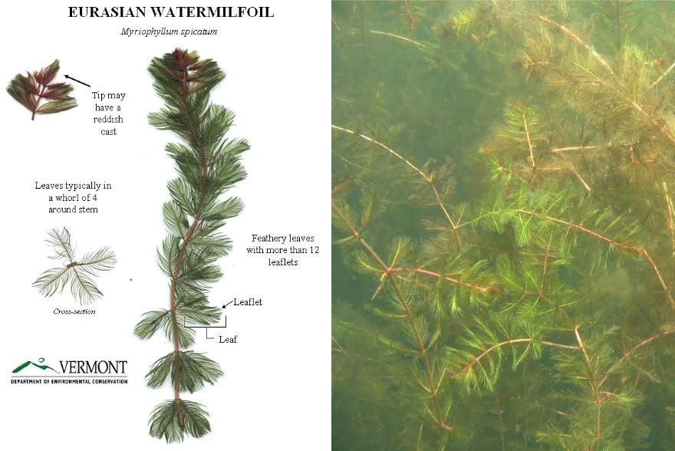

Slide 12
Growing Characteristics of Milfoil
. Grows 3-10 ft tall, forms dense canopies at the surface.
. Prefers shallow, nutrient-rich waters (2-15 ft deep).
. Reproduces mainly by fragments; auto fragmentation in late
summer.
. Tolerates cold; regrows from roots in spring.

Slide 13
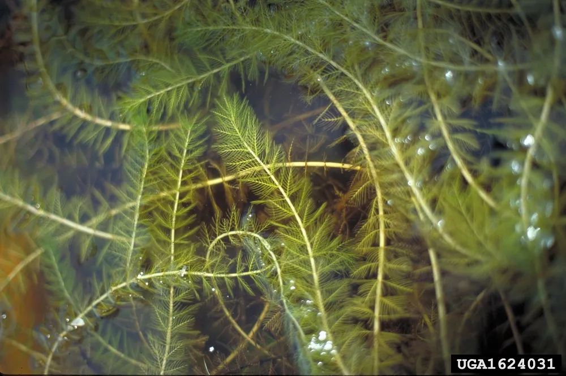

Slide 14
Harms to Water and Ecosystems
Invasive plants cause:
. Displacement of native plants, reducing biodiversity
. Dense mats block sunlight, lower oxygen levels, cause fish kills
. Alter habitats: fewer insects and fish, draws mosquitoes
. Nutrient cycling disrupted, leading to algae blooms
Ecosystems suffer – our fish and wildlife depend on balance

Slide 15
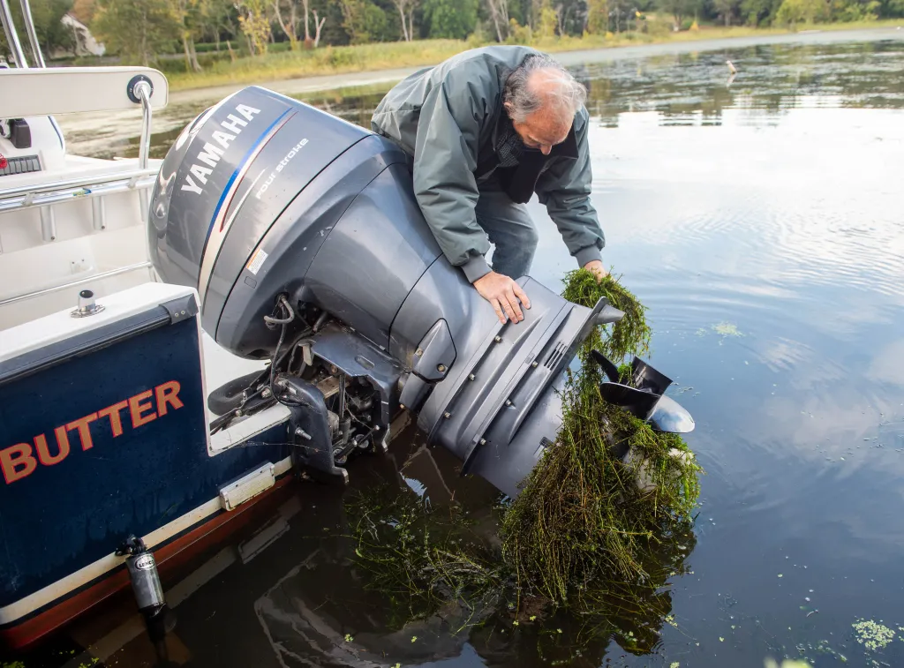
Impacts on Recreation
. Boating: Thick mats of Milfoil and
Hydrilla wrap around propellers,
stalling engines and making navigation
difficult, if not impossible.
. Swimming and Fishing: Dense vegetation inhibits swimming and
reduces fish biodiversity by destroying habitats and reducing
oxygen levels leading to fish kills.
. Ascetics: The foul smelling mats that form on the surface
diminish the natural beauty of the lake.

Slide 16

Impacts on Home Values
. Reduced property Value: Studies indicate
that lakefront properties on infested lakes
can see a 19%-40% decrease in Value.
. Increased Costs: Homeowners and lake associations often face
high expenses for managing and controlling the spread.
. Decreased Desirability: The presence of invasive species reduces
the overall appeal of the lake, leading to lower demand for
homes and lowered property values.

Slide 17
How Invasive Plants Spread
The #1 cause of spread between lakes is human transportation.
Plants travel on:
. Boat Trailers
. Boats, Propellers, in Ballast bags
. Anchors
. Fishing Gear
. Kayaks, Paddleboards and Tubes

Slide 18
Connecticut Lakes facing These Problems
Examples Include:
. Candlewood Lake – 1970’s . Mashapaug Lake - 2014
. Mansfield Hollow Lake – 1970’s . Lake Quassapaug - 2015
. Highland Lake – 2004 . CT River - 2016
. Lake Zoar - 2005 . Twin Lakes (Salisbury) - 2023
. Rogers Lake – 2006 . Gardner Lake - 2023
. Bantam Lake – 2006 . Lake Bashan - 2023
. Coventry Lake – 2008 . Lillinonah - 2024 .
.
The year denotes when Hydrilla or Milfoil were first identified.
Over 40 lakes and ponds are currently Infested in Connecticut.

Slide 19
Local Studies – Twin Lakes (Salisbury)
. Hydrilla detected in 2023 in East Twin; spread to West
Twin and the Shenob Brook (carries water out and flows into the
Housatonic River)
. Impacts: Threatens, swimming, boating, fishing and ecosystem.
Management now includes:
. Herbicide treatments
. Diver surveys
. Monitoring programs
. Intensive lake management

Slide 20
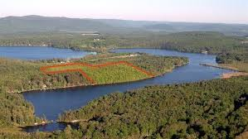
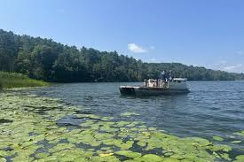
Twin Lake: Real Cost
After Hydrilla appeared:
Annual management spending increased
from roughly $60,000.00 to nearly
$350,000.00 to $500,000.00 per year!!
Additional Expenses:
. Plant surveys $65,000.00 per year
. Herbicide treatment programs
. Monitoring and scientific studies

Slide 21
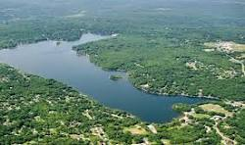
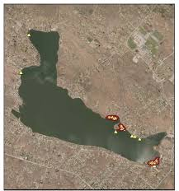
Local Case Studies- Coventry Lake
. Hydrilla first detected in 2016
The state launched a multi-year eradication
program costing millions of dollars.
Hydrilla management includes:
. Herbicide treatment programs
. Sediment tuber monitoring
. Ongoing plant surveys
Estimated annual treatment costs: $100,000.00!

Slide 22
Local Case Studies – Lake Quassapaug
Watermilfoil first appeared 2014
2014-2022 primary method to treat was through suction harvesting
. several boats maned with divers hand removal/6-8 weeks
2022 Significant increase in Milfoil/parts of the lake are non swimmable
non navigable by boat, kayak or paddleboard.
. Suction Harvesting $67,000.00
2023 High levels of Milfoil
. Switch to Herbicide treatments $1,500 per acre (296 acres)
2024-2025
. Herbicide Treatments - $50,000 to $70,000. annually
Private lake – No outside state or federal subsidies

Slide 23
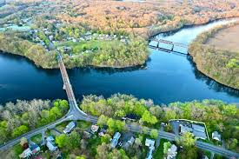
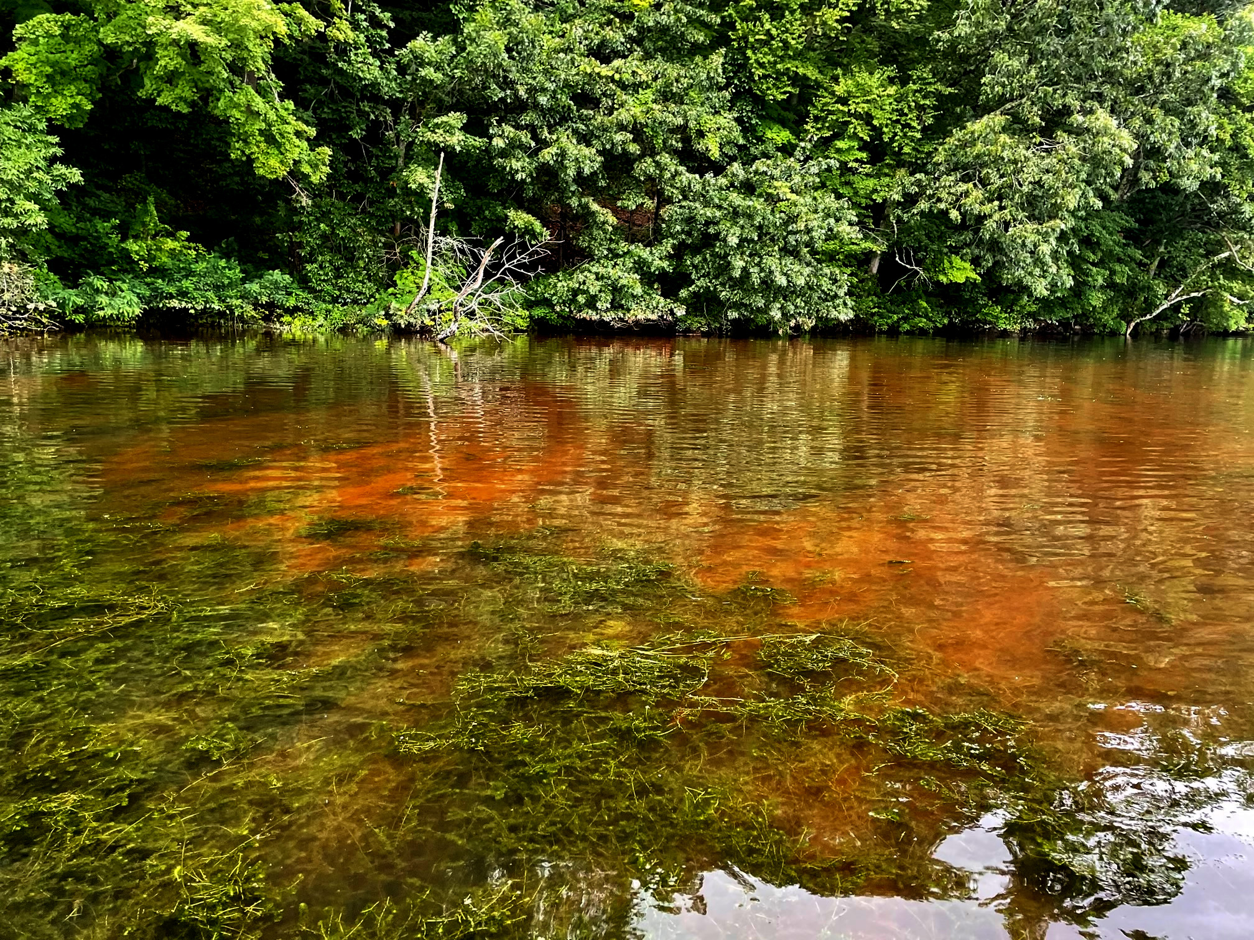
Local Case Studies- CT River
. Infested since 2016; now 70+ miles, 200 + acres affected.
. Impacts: Dense mats harm fisheries, block marinas, impeding
recreational use.
In 2023 the Army Corp of Engineers spent $6 million.
in 2024 the Army Corp of Engineers spent $5 million.
Early 2025 efforts were largely scaled back do to cuts in
Federal funding.

Slide 24
Local Case Studies-Other CT Lakes
: Local Case Studies – Other CT Lakes
Lake | Invasive | Key Issues | Lessons
Candlewood Lake | Milfoil (1970’s) | Dense growth clogged infrastructure; herbicides reduced it. | Annual monitoring prevents rebound.
Lake Bashan | Hydrilla (2023) | Rapid spread from fragments. | Early intervention critical.
Lake Zoar/Lillinonah | Hydrilla (2024) | Affects boating; property value drops. | Community boat inspections help.
Gardner Lake | Hydrilla (2023) | Spread in 1.5 months; harms fishing. | Urgent state aid requested.

Slide 25
What These Lakes teach Us
Rapid Response & Proactivity: Once found, action must be swift. Lake associations in Northwest CT, such as East Twin Lake, demonstrated that closing boat launches immediately and forming coalitions to manage infestations early is critical.
Prevention via Surveillance: Since Hydrilla often arrives via fragments on boat surfaces, boat trailers, and ballast bags, use of strict cleaning protocols and monitoring at boat launches are the best defense.
Vector Management: Recognizing that boats, trailers, fishing gear and even waterbirds can transport fragments, and managing these risks is essential.

Slide 26
Impact on Ecology and Economy: Hydrilla and Milfoil causes severe ecological damage by forming dense mats that reduce oxygen, kill fish, and choke out native plants. It also ruins recreational activities, and can dramatically lower property values.
Education and Monitoring: We must bring awareness and educate our members to recognize the plants and conduct regular, professional surveys to catch new, small infestations before they become widespread.

Slide 27
Potential Costs For Our Lake
Typical lake management costs:
Aquatic plants surveys. $15,000 - $60,000
Herbicide treatments. $100,000 - $200,000
Monitoring programs. $10,000 - $30,000
Boat Inspection Programs $15,000 - $30,000
Total Potential annual cost: $140,000 - $320,000

Slide 28
Cost Per Household
Our Association has 135 Members
If weed management cost:
Total annual cost $140,000 $300,000
Cost per household $1,037 $2,270

Slide 29
Prevention Is the Best Strategy
Preventing invasive plants is far cheaper than managing them!
Early action saves money and protects the lake and our property values

Slide 30
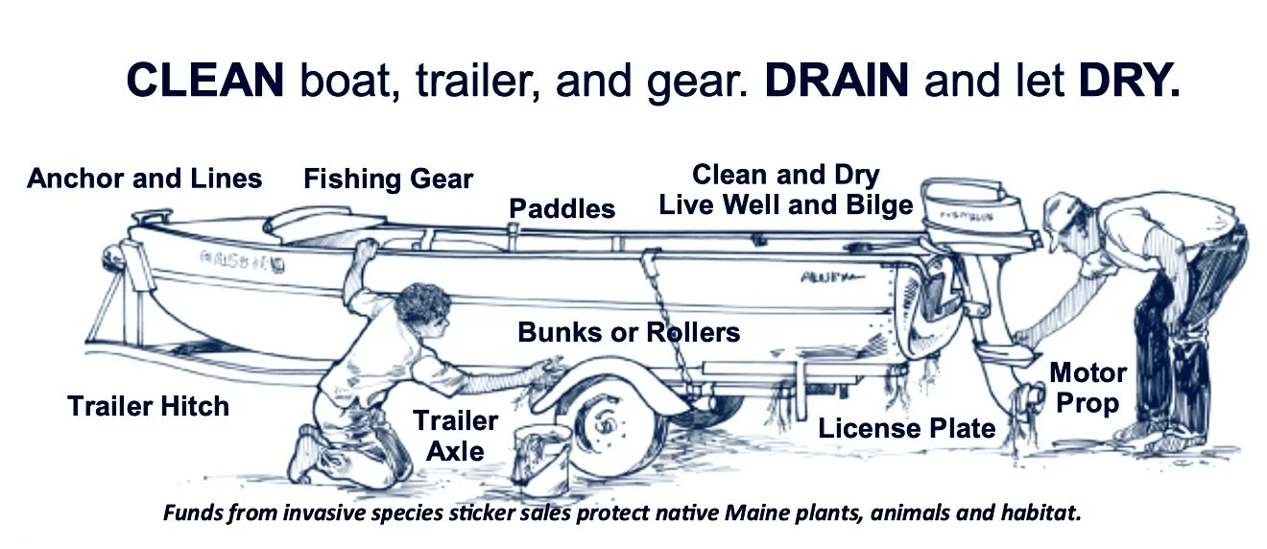
Clean Drain Dry
Standard prevention approach:
Before leaving the water:
. CLEAN: your waders, boat, kayak, canoe, tube, paddleboard
Including any sand, mud, leaves, plant material or algae
. DRAIN: All water from your boat, Ballast bags, kayak or canoe
At Home or prior to your next location
. Dry: Anything that comes into contact with water, boats, trailers,
anchors, propellers, fishing eq., clothing, pets etc.

Slide 31
If drying is not possible:
. Wash with hot water (preferably high pressure).
. Dip equipment into 100% vinegar solution for 20 minutes
prior to rinsing.
. Use 1% salt solution (1oz. Per gallon) or soap and hot water
(Lysol or boat soap) for 10 minutes prior to rinsing.

Slide 32
What Our Lake Association Can Do
Possible Proactive actions:
. Implementation and Enforcement of Boat Cleaning Protocols
. Boat Launch monitoring
. Volunteer lake stewards / committee
. Annual plant surveys
. Education programs

Slide 33
What Our Members Must Do
. Clean, Drain and Dry; Boats, trailers, canoes, kayaks, gear etc.
. Avoid infested waters
. Don’t release aquarium plants and fish in the lake
. Volunteer for boat cleaning protocol inspections / enforcement
. Volunteer for boat launch inspections
. Report sightings to CLOA board immediately
Your actions matter – one clean boat prevents spread

Slide 34
Key Takeaways
Preventing invasive plants today can save $$$ millions over time.
The continued health of our lake benefits every member/homeowner.

Slide 35
Our Goal
To Protect the health of Cedar lake for future generations, thereby
Providing:
. Recreation (swimming, boating, fishing, etc.)
. Wild life habitat preservation
. Clean water
. Strong property values

Slide 36

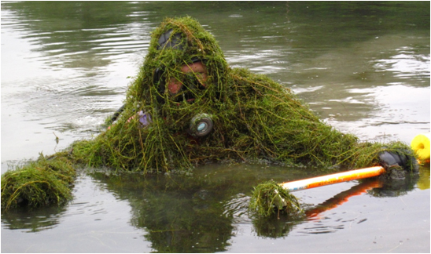
In Case You Need More Convincing
How would you like to enjoy your day on the water?
Like this Or like this

